Slide 1

Notes:
Hello everyone,
I am Glen
I work for this company

Slide 2




Glen R. Goodwin
@areinet
arei.net
github.com/arei
Notes:
And I'm here to tell you about
what may be the single greatest achievement
in Web Browser Technology.
Ever.
EVER.
It's called ZephJS

Slide 3

Notes:
and it's going to change your life.
But, before I can tell you about ZephJS,
I need to tell you about Web Components.

Slide 4

WEB COMPONENTS
Notes:
And I know that a few months ago,
We had Shane come in here
and talk about writing web components.
So instead of giving you all that again.
I'm going to summarize exactly what he said
In two short bullet points...

Slide 5
AWESOME
Notes:
1). Web Components are AWESOME

Slide 6

Notes:
2). Glen is an incredibly handsome man.
Not sure why he said that last bit
but it is absolutely what happened.
[pause]
Seriously though,

Slide 7
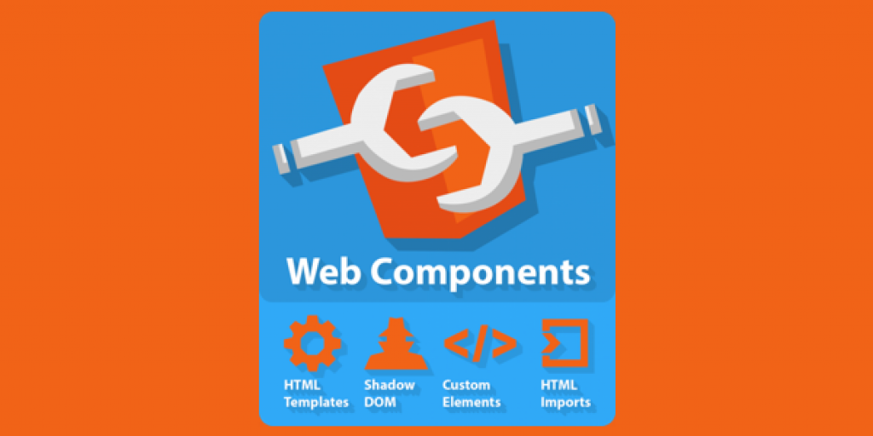
Notes:
Shane told us all about
how Web Components are
a collection of Browser API standards
that make writing
custom HTML tags possible.

Slide 8
<my-awesome-button>
</my-awesome-button>
Notes:
This means if I want to create <my-awesome-button>
it is possible with web components.
As Shane showed us
A Web Component,

Slide 9
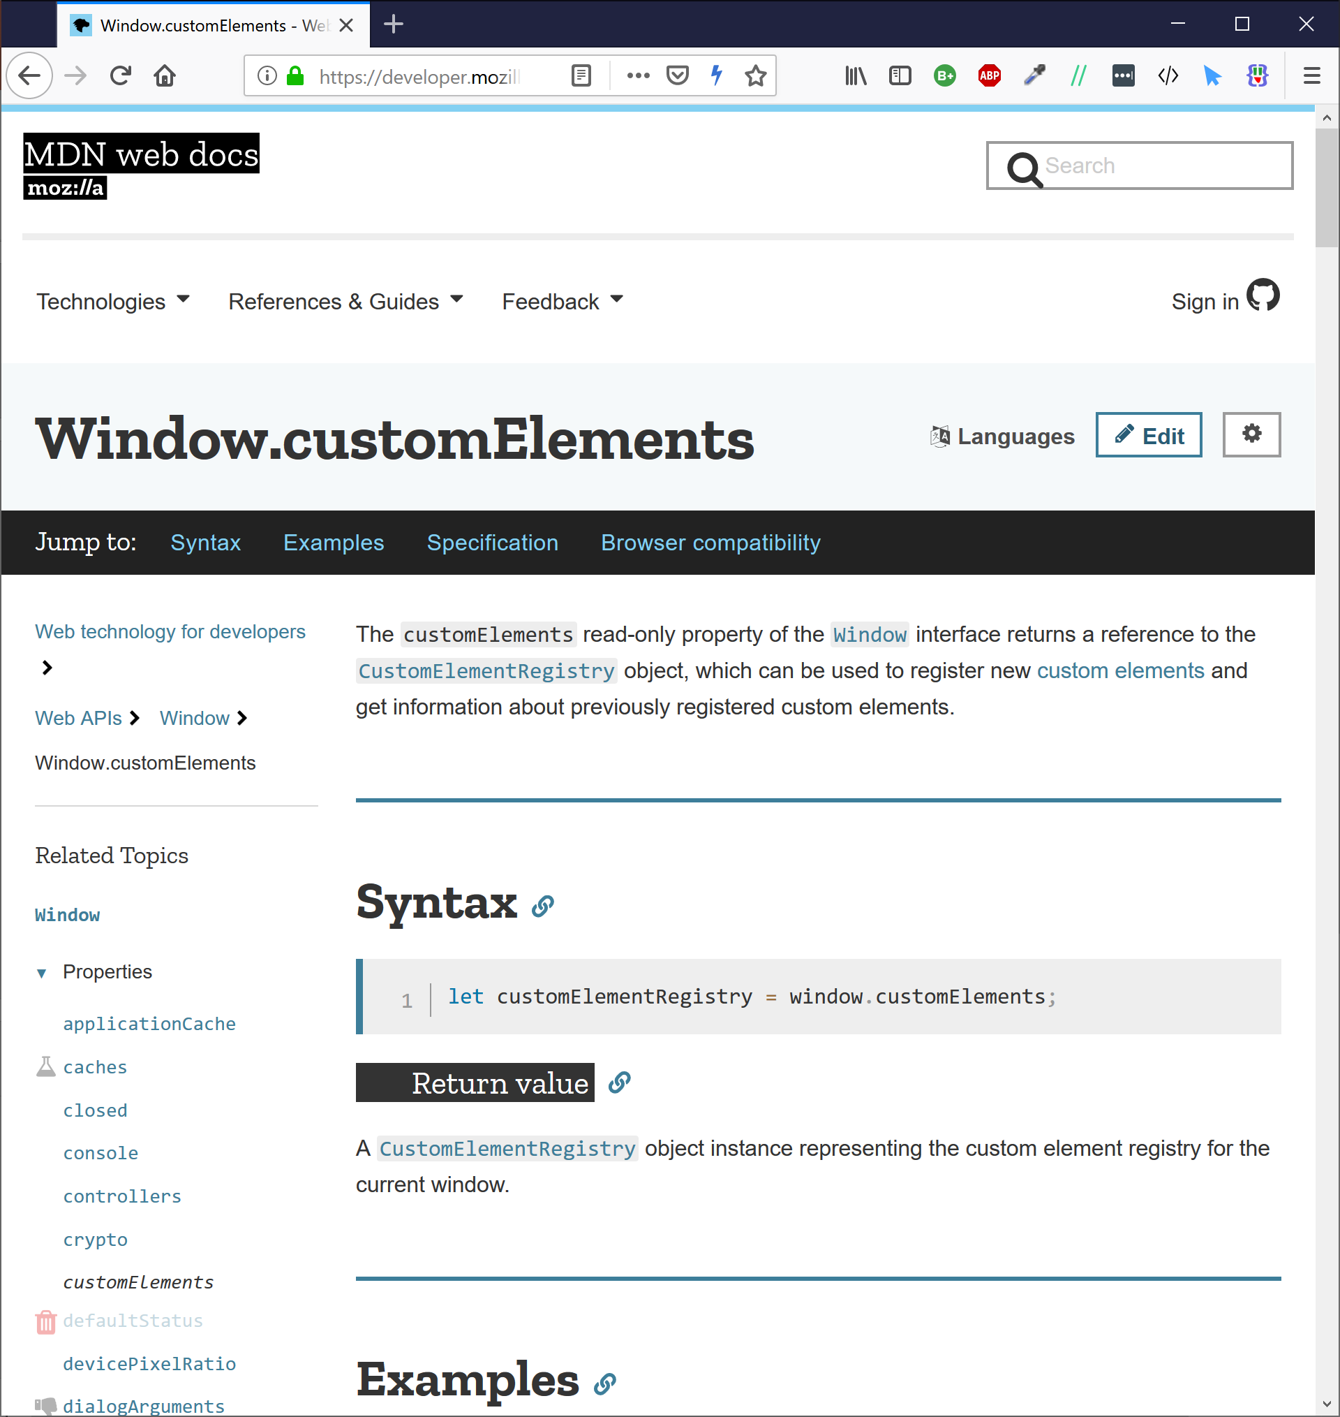
Notes:
uses the Custom Elements API
to register a Component Class
That will be instantiated whenever
the given tag name is used.

Slide 10
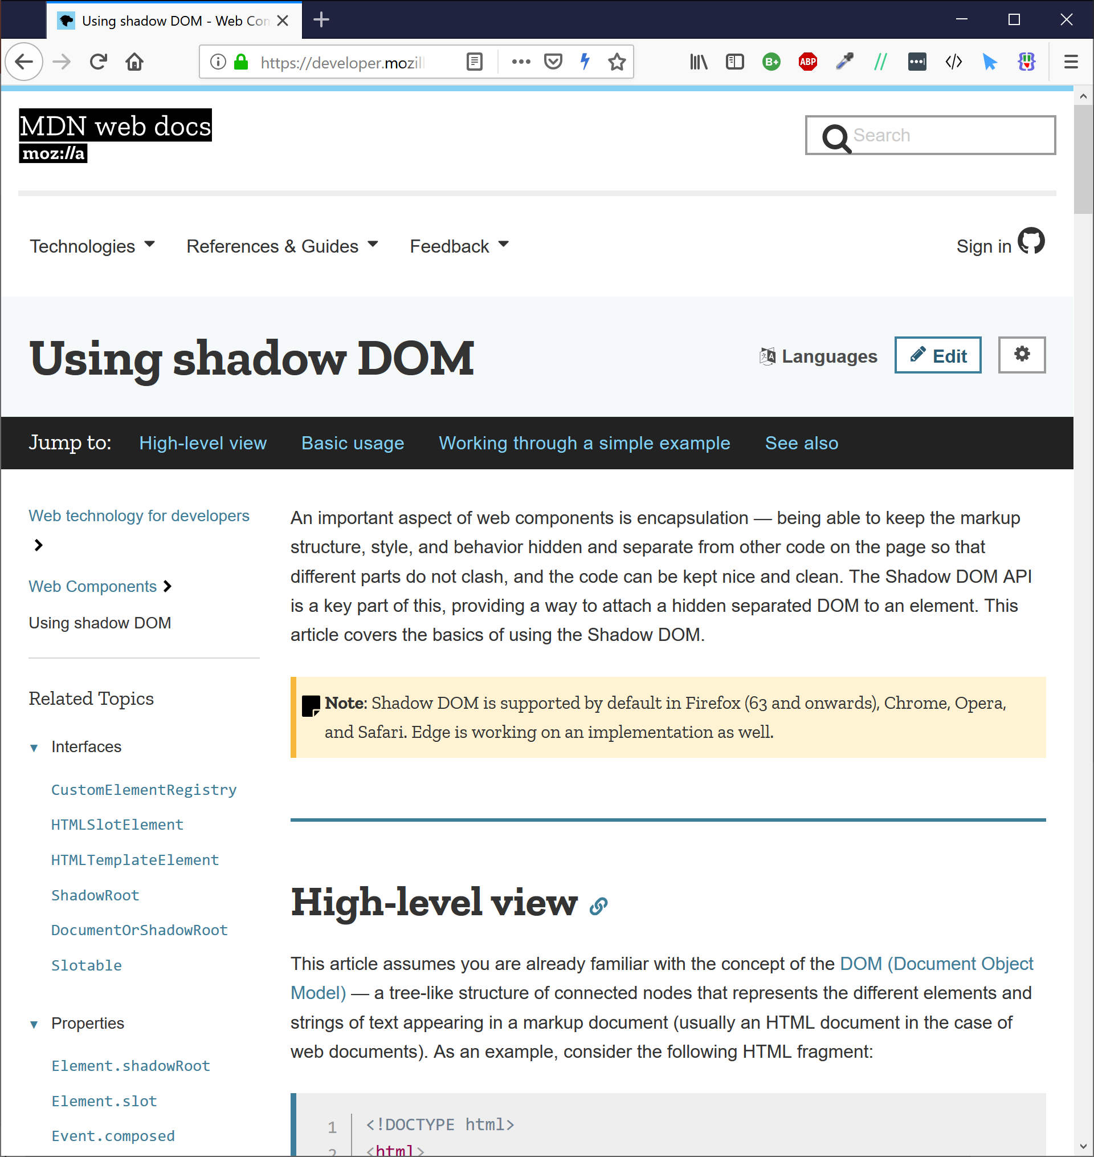
Notes:
When the Component class
is instantiated
We attach a ShadowDOM root to it
which allows us to insert
content and style
into the element
that is isolated
from the rest of the DOM.

Slide 11

<body>
<twtr-tweet-viewer style=“list”>
<twtr-tweet tweetId=“45yhbwrh356hw34t3w4gtqerf”>
Try ZephJS!
It’s the bomb!
</twtr-tweet>
<twtr-tweet tweetId=“wgreg24g5w4g25g3bt35545g”>
<twtr-tweet-media src=“images/4253452345234523452rgs”>
<twtr-tweet-media>
</twtr-tweet>
<twtr-tweet tweetId=“234652tgtbwgw346h43g53fq3”>
In Endgame when Thor dies a horrible death.
It’s gruesome.
</twtr-tweet>
<twtr-tweet tweetId=“234tgb5y36g34fv246245w3va”>
<twtr-tweet-media src=“images/245yh3yb364wgegaasdfg”>
<twtr-tweet-media>
Notes:
This provides us with
a customized
encapsulated
HTML element
for use anywhere in our web document

Slide 12
<body>
<twtr-tweet-viewer style=“list”>
<twtr-tweet tweetId=“123”>
</twtr-tweet>
<twtr-tweet tweetId=“456”>
</twtr-tweet>
<twtr-tweet tweetId=“789”>
</twtr-tweet>
<twtr-tweet tweetId=“abc”>
</twtr-tweet>
<twtr-tweet tweetId=“def”>
</twtr-tweet>
</twtr-tweet-viewer>
</body>
Notes:
Any time you can envision
a custom
repeatable
display and behavior
for a web page
you should be reaching
for a web component.
This includes when you build
a complex web application
out of a collection of nested web components
or whether you just want
to offer a feature that
HTML does not currently have.

Slide 13

Not really a picture of Shane
Notes:
Now,
Like I said,
Shane already covered how to use
the defined web component standards
and did a great job of that

Slide 14
Not really a picture of Shane
Notes:
but honestly,
you need to forget a lot of what he said.

Slide 15
Web Page
ShadowDOM
Custom
Elements
API
HTML
Templates
Browser APIs
Notes:
The author's of the web component standards
never really intended for everyone
to have to understand how ShadowDOM works
or how CSS flows into or out of a Web Component.

Slide 16
Web Page
Web Component Helper Library
ShadowDOM
Custom
Elements
API
HTML
Templates
Browser APIs
Notes:
Instead, the goal of Web Components
was to provide a set of low-level APIs
that libraries,
could wrap up into a
higher order system.
And that's where ZephJS fits in

Slide 17
Web Component Helper Library
Notes:
ZephJS is a Web Component helper library,
meaning that it
Helps your write Web Components.
If you are familiar with the space,
the lit-element project
is a good comparison.

Slide 18
ZephJS is an easy, understandable, and ultra-light framework for defining and using Web Components. It is perfect for people writing component libraries, teams building applications or sites that just require a few custom components, or projects building whole applications that do not want all the weight of a modern JavaScript Browser framework. ZephJS simplifies the process of defining custom Web Components into a declarative highly readable structure that uses standard JavaScript, standard HTML markup, and standard CSS Styling.
Notes:
Except ZephJS isnt the same.
With ZephJS you just focus
on the component...
No need to monkey about with the ShadowDOM
or the custom elements api
Or render templates
or virtual DOMs
or any of the hundereds of things
modern frameworks saddle us with.

Slide 19
import {ZephComponents,html,css,attribute,property,bind,onEvent}
from "./Zeph.js";
ZephComponents.define("my-list",()=>{
html("./my-list.html");
css("./my-list.css");
attribute("value","");
attribute("label","");
property("value","");
bind("@label","label","$");
bind("@value",".",".value");
onEvent("click",(event,element)=>{
…
});
});
Notes:
With ZephJS
You just write your component
with declarative syntax
using standard HTML,
standard CSS,
and standard JavaScript.
Nothing Fancy.
ZephJS provides everything a developer needs
to define a web component
in simple,
readable language
with almost no overhead.
At last look,
ZephJS minified
was less than 21k.
[pause]
So let us look at how ZephJS works...

Slide 20
import {ZephComponents,html,css,attribute,property,bind,onEvent} from "./Zeph.js";
ZephComponents.define("my-list",()=>{
html("./my-list.html");
css("./my-list.css");
attribute("value","");
attribute("label","");
property("value","");
bind("@label","label","$");
bind("@value",".",".value");
onEvent("click",(event,element)=>{
…
});
});
Notes:
at the heart of ZephJS is the
`ZephComponents.define()` method.
To this function you provide two arguments:

Slide 21
import {ZephComponents,html,css,attribute,property,bind,onEvent} from "./Zeph.js";
ZephComponents.define("my-list",()=>{
html("./my-list.html");
css("./my-list.css");
attribute("value","");
attribute("label","");
property("value","");
bind("@label","label","$");
bind("@value",".",".value");
onEvent("click",(event,element)=>{
…
});
});
Notes:
The tag name if the component you wish to define
The tag name must be
- at least three characters long
- and must have at least one dash character in it.
Otherwise call it whatever you want.

Slide 22
import {ZephComponents,html,css,attribute,property,bind,onEvent} from "./Zeph.js";
ZephComponents.define("my-list",()=>{
html("./my-list.html");
css("./my-list.css");
attribute("value","");
attribute("label","");
property("value","");
bind("@label","label","$");
bind("@value",".",".value");
onEvent("click",(event,element)=>{
…
});
});
Notes:
and a definition function in which you describe the component.
The definition function
is a standard javascript function
(or arrow function)
in which you call one or more definition methods.

Slide 23
import {ZephComponents,html,css,attribute,property,bind,onEvent} from "./Zeph.js";
ZephComponents.define("my-list",()=>{
html("./my-list.html");
css("./my-list.css");
attribute("value","");
attribute("label","");
property("value","");
bind("@label","label","$");
bind("@value",".",".value");
onEvent("click",(event,element)=>{
…
});
});
Notes:
Definition methods describe various aspects of your component.
For example, the `html()` definition method describes
the internal HTML of the component.
The `attribute()` definition method describes
an attribute of the component.
There are currently eighteen different definition methods
Some of the more interesting ones ar

Slide 24
import {ZephComponents,html,css,attribute,property,bind,onEvent} from "./Zeph.js";
ZephComponents.define("my-list",()=>{
html("./my-list.html");
css("./my-list.css");
attribute("value","");
attribute("label","");
property("value","");
bind("@label","label","$");
bind("@value",".",".value");
onEvent("click",(event,element)=>{
…
});
});
Notes:
The html() definition method
is used to indicate the internal content
of the component.
It can be a string of inline HTML
or it can be a url or relative path reference
to an external file.

Slide 25
import {ZephComponents,html,css,attribute,property,bind,onEvent} from "./Zeph.js";
ZephComponents.define("my-list",()=>{
html("./my-list.html");
css("./my-list.css");
attribute("value","");
attribute("label","");
property("value","");
bind("@label","label","$");
bind("@value",".",".value");
onEvent("click",(event,element)=>{
…
});
});
Notes:
the css() definition method
is used to indicate the styling
for the component and the internal content.
It can be a string of inline CSS
or it can be a url or relative path reference
to an external fil

Slide 26
import {ZephComponents,html,css,attribute,property,bind,onEvent} from "./Zeph.js";
ZephComponents.define("my-list",()=>{
html("./my-list.html");
css("./my-list.css");
attribute("value","");
attribute("label","");
property("value","");
bind("@label","label","$");
bind("@value",".",".value");
onEvent("click",(event,element)=>{
…
});
});
Notes:
The attribute() definition method
is used to indicate that the component has
an attribute.

Slide 27
import {ZephComponents,html,css,attribute,property,bind,onEvent} from "./Zeph.js";
ZephComponents.define("my-list",()=>{
html("./my-list.html");
css("./my-list.css");
attribute("value","");
attribute("label","");
property("value","");
bind("@label","label","$");
bind("@value",".",".value");
onEvent("click",(event,element)=>{
…
});
});
Notes:
The property() definition method
is used to indicate that the componnet has
a exposed javascript property.

Slide 28
import {ZephComponents,html,css,attribute,property,bind,onEvent} from "./Zeph.js";
ZephComponents.define("my-list",()=>{
html("./my-list.html");
css("./my-list.css");
attribute("value","");
attribute("label","");
property("value","");
bind("@label","label","$");
bind("@value",".",".value");
onEvent("click",(event,element)=>{
…
});
});
Notes:
ephJS has no templating language
and no template parser
or complicated psuedo-html interpolation.
Instead, if you want some part
of an element or internal content element
to change, you have to do it yourself.
ZephJS, of course,
makes this super easy to do
with bindings.
Binding lets you identify
a source element,
a source type,
a target element,
and a target type.
When the source item of the source element changes
The changed value
is copied to the target type
on the target element.
For example you can say
if the "value" attribute
of the custom element
changes,
copy it to the content of
the second DIV tag
in the internal content
`bind("@value","div:nth-child(2)","$")`
Or
if the "value" property
of the text input field with the component
changes,
copy it to the "data-value" attribute
of the element.
`bindAt("input[type=text]",".value",".","@data-value")`
The difference between bind() and bindAt()
is that bind() assumes the source element
is the current element.
whereas bindAt()
allows you to specify the source element.
bind() is a really useful concept in ZephJS
and saves you a ton of typing.

Slide 29
import {ZephComponents,html,css,attribute,property,bind,onEvent} from "./Zeph.js";
ZephComponents.define("my-list",()=>{
html("./my-list.html");
css("./my-list.css");
attribute("value","");
attribute("label","");
property("value","");
bind("@label","label","$");
bind("@value",".",".value");
onEvent("click",(event,element)=>{
…
});
});
Notes:
The onEvent() and onEventAt() definition methods
are used to associate an event listener
with the element
or an element within the internal content.
onEvent() adds the listener
to the element.
It takes the eventType as the first argument
and the listener function as the second.
onEventAt() adds the listener
to some element within the internal content.
It takes a CSS Query Selector as the first argument.
the eventType as the second argument.
and the listener function as the third argument.
[pause]

Slide 30
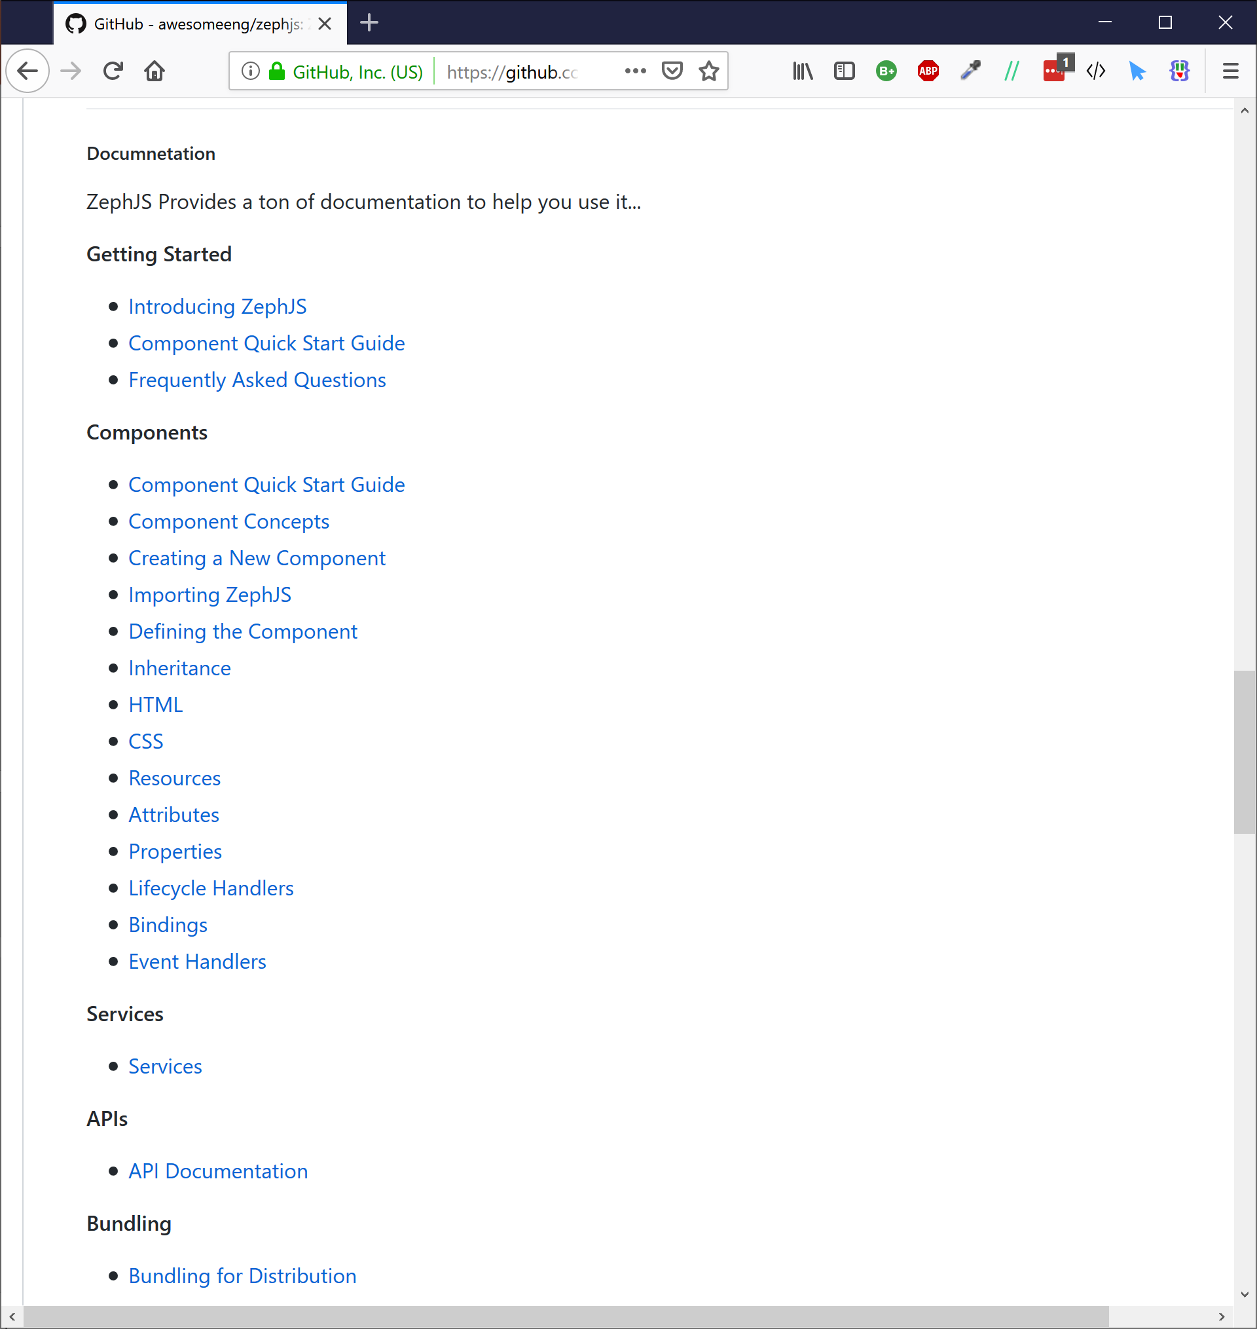
Notes:
There are a few other definition methods
for doing things like
handling lifecycle events
or inheriting from another ZephJS component.
Everything is carefully enumerated
in the documentation.

Slide 31
./my-widget.js
ZephComponents.define(“my-widget”,()=>{
… definition methods …
});
ZephJS
Component
Context
Component
Class
./index.html
…
<my-widget>
</my-widget>
…
Custom Elements
Registry
Notes:
Once you have defined your component,
ZephJS executes the definition function
and builds what is called a Component Context,
which describes the component completely.
It then registers the given name
with the Custom Elements API
using a custom Component Class
that when instantiated
uses the Component Context
to setup the component.

Slide 32
./my-widget.js
ZephComponents.define(“my-widget”,()=>{
… definition methods …
});
MAGIC!
ZephJS
Component
Context
Component
Class
./index.html
…
<my-widget>
</my-widget>
…
Custom Elements
Registry
Notes:
That sounds really complicated,
lets just say some magic happens
and ZephJS turns your name and definition
into a registered custom element
and you are good to go.
Alright, that's all the slides, lets get into it and build something...

Slide 33

Notes:
For our very contrived example, let us build a Star Rating component.
You know the type of thing like on netflix.
Where you click on a star and that's how much you like
that movie or tv show or whatever.
We will keep it pretty standard.
Our <rating-stars> component
will allow the user to
rate the associated item
from 0 to 5 stars, no fractional stars allowed.
Clicking a higher star indicates a higher rating,
clicking a lower star indicates a lower rating.
We want the component to show both the number of stars
and the text of what is being rated...

Slide 34
LIVE CODING
Notes:
So let's get at it...

Slide 35

ZephJS
npm repo zephjs
github.com/awesomeeng/zephjs
Glen R. Goodwin
Awesome Engineering
Notes:
So that is ZephJS.
I hope you all find it
as easy to use and read
as I do.
There is a ton of documentation available here.
I do have one last request
of everyone here
before we go drink beer...

Slide 36



Try
Star
Tweet
Notes:
Please give ZephJS a try.
Please give ZephJS some github stars.
And please help me spread the word
by tweeting and retweeting ZephJS.
I am super excited about it
and I really want to see it
and the community around it grow.
And I cannot do it
Without your help today.

Slide 37

Still not a picture of Shane buying you Free Beer
Notes:
In fact, if you come to the bar
and find me
and promise me you are going
to try, star, and tweet
about ZephJS
I will make Shane buy you a beer.
Thanks Shane!
You’re alright.

Slide 38
ZephJS
npm repo zephjs
github.com/awesomeeng/zephjs
Glen R. Goodwin
Awesome Engineering
Notes:
Thanks you everyone.
Let's go get pissed.

